Slide 1

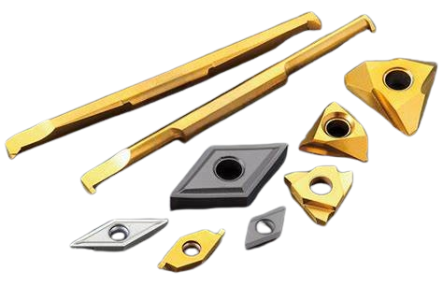
TOOL WEAR CONDITION MONITERING USING MACHINE LEARNING ALGORITHMS
- S.B.BHADRINATHAN
S.MANOJ KANNAN

Slide 2



SYNOPSIS
Introduction
Problem statement
Data collection & preprocessing
Model selection
Model evaluation
Conclusion

Slide 3

INTRODUCTION
Leveraging AI in manufacturing industries promises a boost in machine productivity.
This system aims immense value in achieving zero-rejection production and maintaining high-quality standards within the automated manufacturing landscape, such as in Industry 4.0 environments.
Diverse machine learning algorithms play a pivotal role in training the model with sound waves for optimal performance.

Slide 4

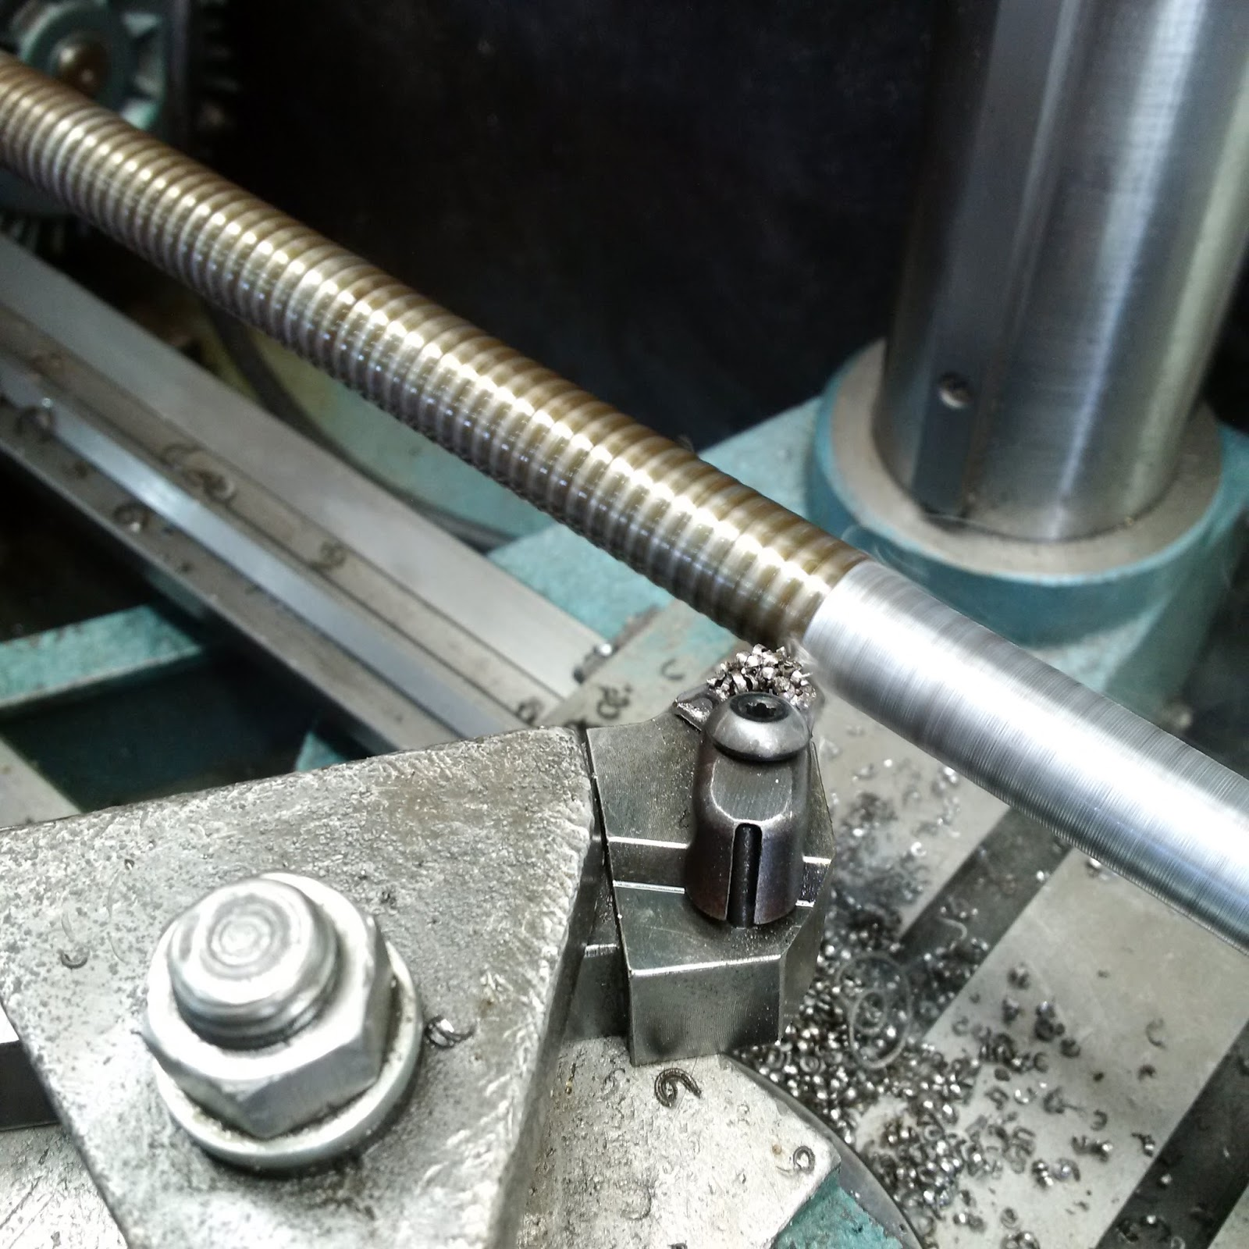
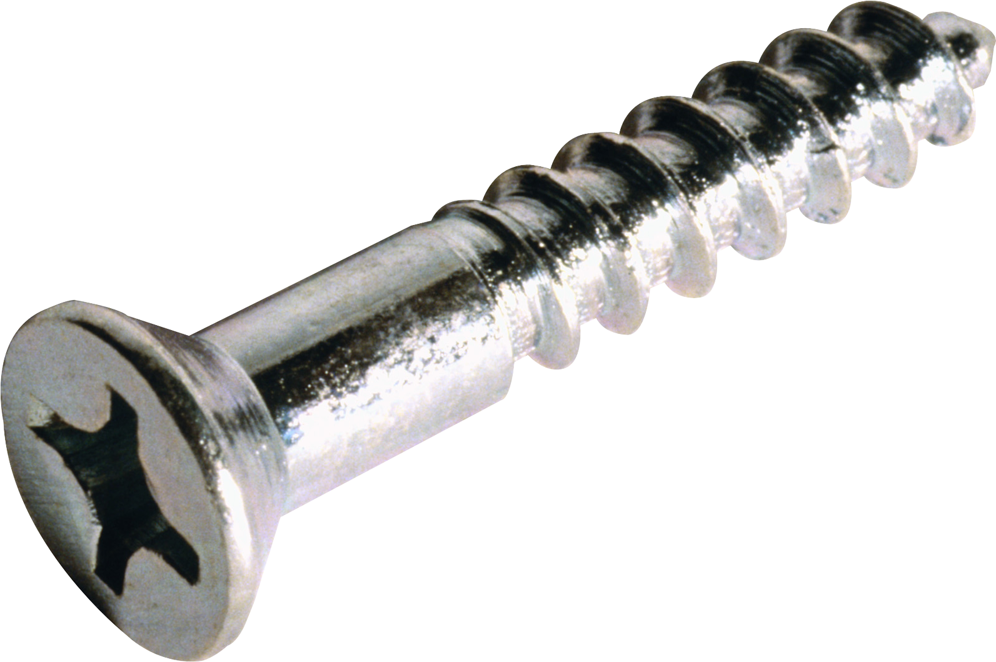
PROBLEM STATEMENT
A malfunction in the curving tool not only impacts production but also incurs significant costs.
The delivery schedule is at risk when products are imperfect, potentially leading to delays.

Slide 5

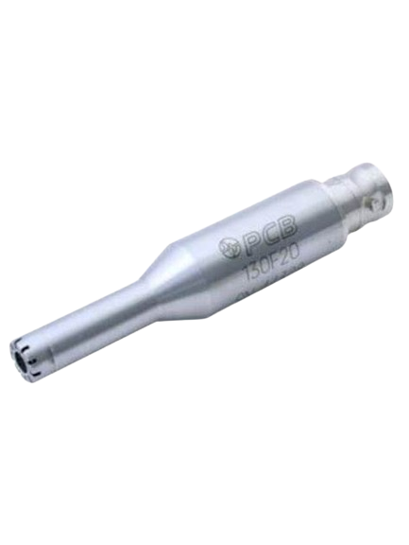
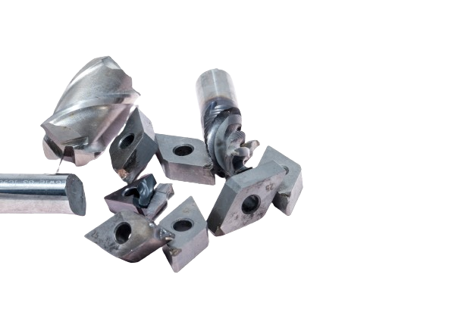
DATA COLLECTION
The PCB 130 D 20 microphone is expertly deployed for capturing high-quality sound recordings.
The spindle maintains a steady rotation at a consistent speed throughout the operation.
Aluminum job with the carbide tool is used in this machining process.
Three types of tool is used to collect data.
Fresh – new tool
Slight – slightly worn tool
Severe – severely worn or cracked

Slide 6

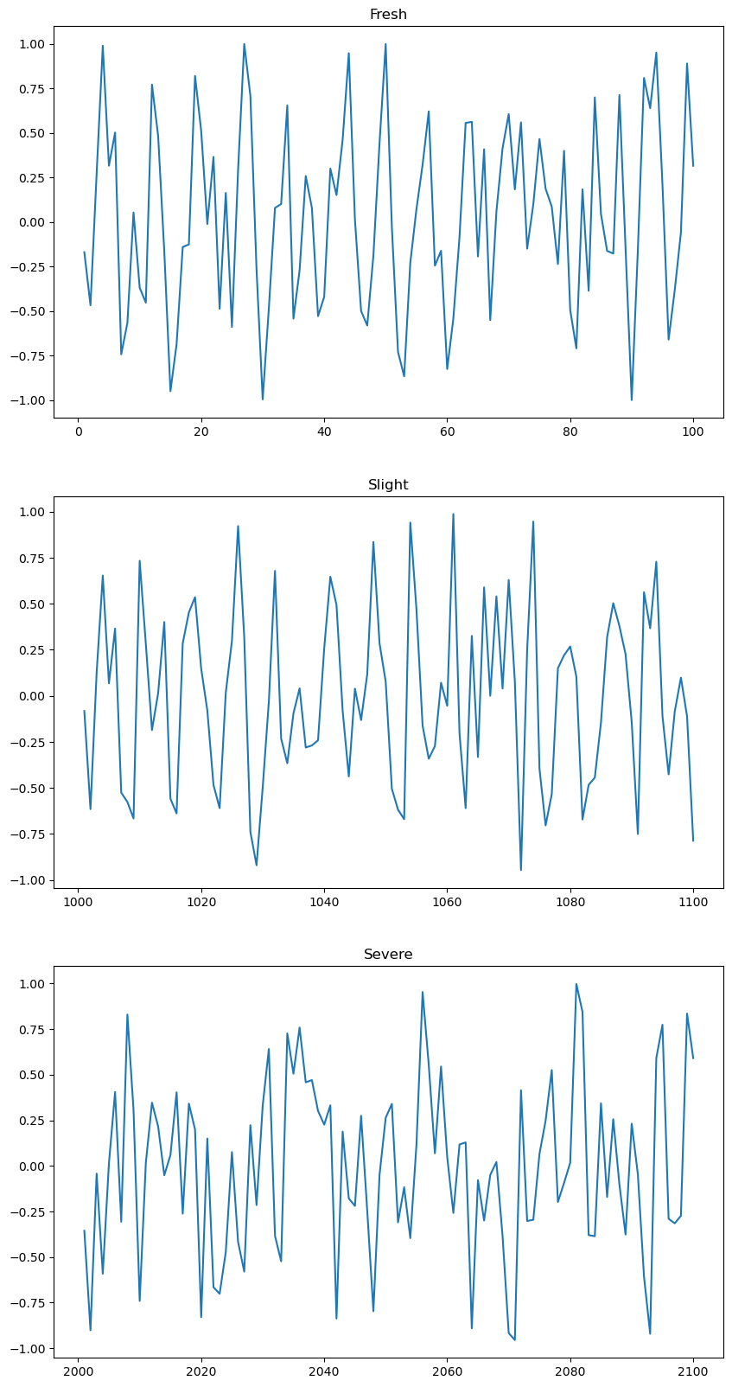
DATA PREPROCESSING
44100 data points are recorded per second.
Selected upper and lower points.
Reduction of data points will avoid the overfitting.
Certain number of data points are grouped to segment the wave form.

Slide 7
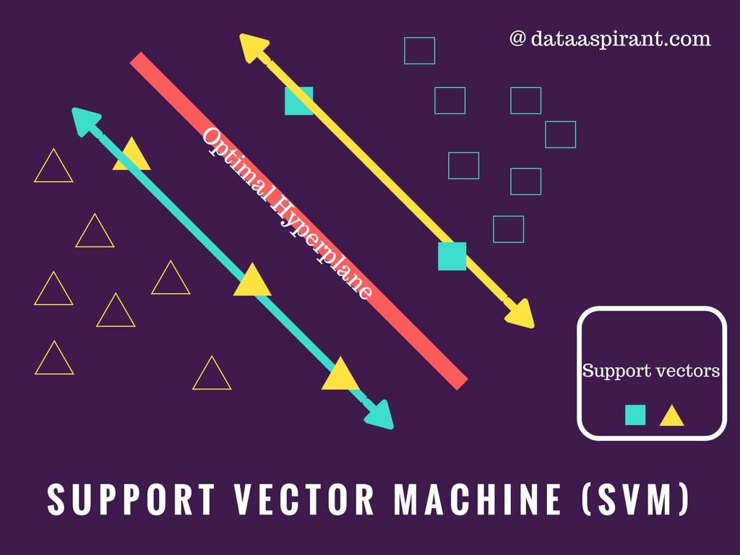
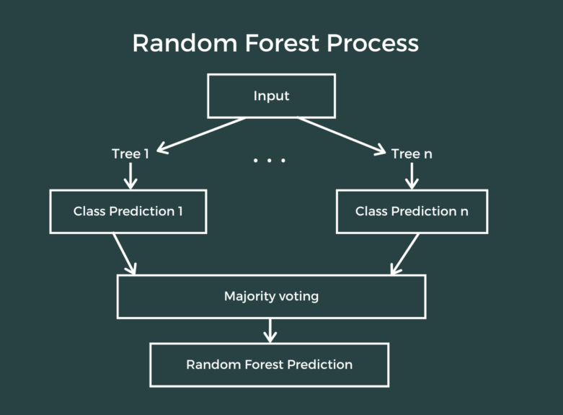
MODEL SELECTION
A diverse array of supervised, unsupervised, and neural network algorithms are carefully chosen for training the model.
After meticulous evaluation, the top wave pattern recognition algorithms have been selected for the task at hand.

Slide 8
MODEL EVALUATION
Support Vector Machine Accuracy: 63.33
Random Forest Accuracy: 70.00
Gradient Boosting Accuracy: 73.33
Logistic Regression Accuracy: 63.33
Multilayer Perceptron Accuracy: 90.00

Slide 9
CONCLUSION
By closely monitoring the condition of cutting tools, achieving zero rejection rates becomes attainable.
Early detection of tool conditions allows for proactive maintenance.
This initiative will alleviate the workload on employees.
We have the potential to expand this project to encompass other machines.

